Slide 1
Mat. K.M. Patel Senior College of Science & Commerce, Thakurli(E)
Topic: Technology Development
Developed By
Shiva Vishwakarma (SY BSc-IT)
Priyanka Mohite (SY BSc-IT)
Hitesh Patidar (FY BSc-IT)

Slide 2

Technology Development
This is the name of our website i.e Technology Development.
This contains how to do the business of developing the websites, application, IoT-Based Object and AI-Based Object.

Slide 3
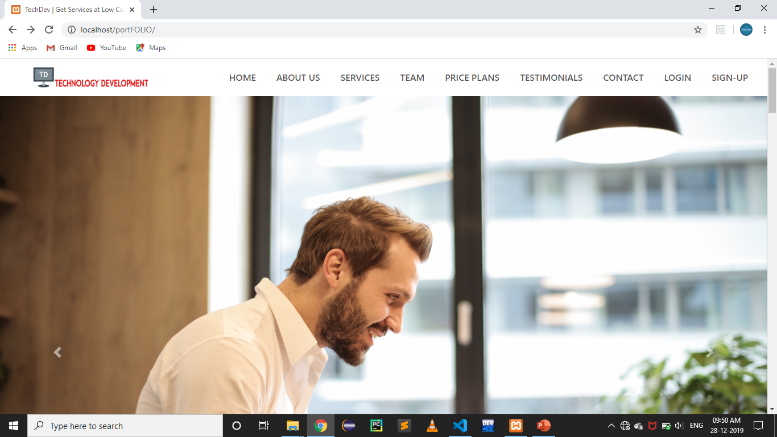
This is how the website Home Page looks.

Slide 4
Web Technology used to develop this website are:
HTML
CSS
Bootstrap
JS
MySQl
PHP

Slide 5
How is the website structured?
The website is structured by containing some of the menu-bars which are as follow:
Home
About Us
Services
Team
Price Plans
Testimonials
Contacts
Login
Sign-Up

Slide 6
Home
By clicking onto the “Home” menu bar you will get to the my Home page.
Its simple as almost every website do contain.

Slide 7
About Us
By clicking onto the “About Us” menu bar, you will jump to the “About Us” section of my website.
It contains about us that what we actually are by profession.
This section also demonstrates how our team members are dedicated to the work by showing the progress bar into the development field.

Slide 8
Services
The services which we provide are as follow:
Web Development
App Development
IoT-Based Object
AI-Based Object

Slide 9
Team
This section contains some of the details of our team members, for example you will get to know some of the details by their social media icons.

Slide 10
Price Plans
This would contains some of the price plans for the development of technologies.

Slide 11
Testimonials
This section contains the some of our testimonials.
You can get some details about our testimonials by their social media icons.

Slide 12
Contacts
This is the contact section where you will get some of the information & you can be get in touch with one of our team members regarding the help and development purpose.

Slide 13
Sign-up
This is the sign-up page where the users will register/sign-up their account.

Slide 14
Login
This is the login page where the users log their signup account.

Slide 15
Thanks for paying the attention.

